Slide 1
Recommender Systems

Slide 2
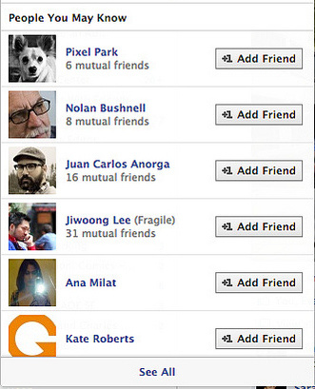
Facebook: “People You May Know”

Slide 3
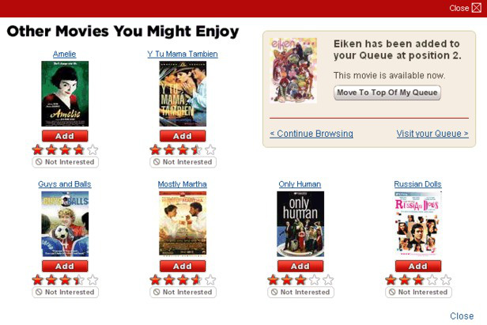
Netflix: “Other Movies You Might Enjoy”

Slide 4

LinkedIn: “Jobs You May be Interested In”

Slide 5
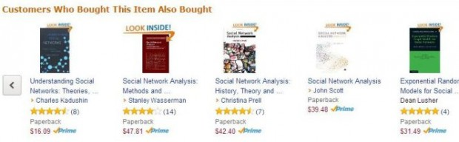
Amazon: “Customers Who Bought This Item Also Bought…

Slide 6
What are Recommender Systems?
Algorithms to mine patterns in huge datasets to learn and identify user behavior and filter out items that can be recommender to a user
Two elements of a recommender system – user & item
Users have preference for certain items – aim of the RS is to learn this preference

Slide 7
Why do we need Recommender System?
Long Tail Phenomenon
Item Popularity
Item Frequency

Slide 8
Basics of RE
Item-Feature Matrix
User-Feature Matrix
Item | Battery | Display
Phone1 | 0.9 | 0.1
Phone2 | 1 | 0
Phone3 | 0.1 | 0.9
Phone4 | 0 | 1
User | Battery | Display
User1 | 0.9 | 0.1
User2 | 0.8 | 0.2
User3 | 0.1 | 0.9
User4 | 0.01 | 0.99

Slide 9
Types of RE
Recommender Engines
Content Based Filtering
Collaborative Filtering
Dimensionality Reduction
Recommendation is done based on the property of the items recommended
Recommendation is done based on similarity measures between users and/or items
Recommendation is done based on reducing the dimensionality of the utility matrix

Slide 10
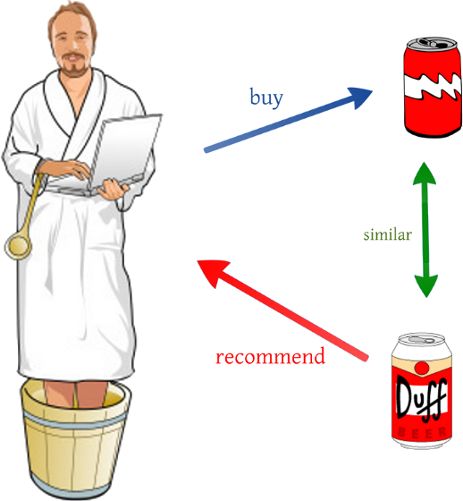
Content Based Filtering

Slide 11
Content Based Filtering
Recommendation is made based on similarity comparison between the content of the items and the user’s profile
User | Battery | Display
User1 | 0.9 | 0.1
User2 | 0.8 | 0.2
User3 | 0.1 | 0.9
User4 | 0.01 | 0.99
User | Feature Vector
User1 | [0.9, 0.1]
User2 | [0.8, 0.2]
User3 | [0.1, 0.9]
User4 | [0.01, 0.99]
Item | Battery | Display
Phone1 | 0.9 | 0.1
Phone2 | 1 | 0
Phone3 | 0.1 | 0.9
Phone4 | 0 | 1
Item | Feature Vector
Phone1 | [0.9, 0.1]
Phone2 | [1, 0]
Phone3 | [0.1, 0.9]
Phone4 | [0, 1]

Slide 12
Content Based Filtering
Recommendation is made by
Max(U(j)^{T}.I(i))
For User 1: Max(U(1)^{T}.I(1), U(1)^{T}.I(2), U(1)^{T}.I(3), U(1)^{T}.I(4)) = Max(0.82, 0.9, 0.18, 0.1)
Hence Recommend Phone2, Phone1, Phone3, Phone4 in that order to User1
Cosine Distance, might need feature scaling

Slide 13
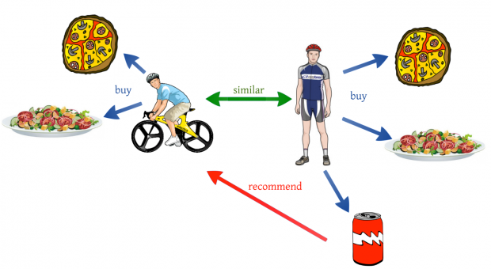
Collaborative Filtering

Slide 14
Collaborative Filtering
Problem with CBF – Need to know & evaluate the various features of the items
CF considers similarity in User Behavior, instead of that in Items to make a recommendation
If User A ~ User B => Recommend Items that User A likes to User B

Slide 15
Collaborative Filtering
We start with the same User-Feature Matrix. How do we get this?
User Reviews
User Ratings
Surveys
User | Battery | Display
User1 | 0.9 | 0.1
User2 | 0.8 | 0.2
User3 | 0.1 | 0.9
User4 | 0.01 | 0.99

Slide 16
Collaborative Filtering
This time we have a User-Behavior matrix instead of Item-Feature Matrix
Goal is to derive features of Items using the User-Behavior matrix
 | User1 | User2 | User3 | User4
Item1 | 5 | 4.5 | - | -
Item2 | 5 | - | 0.5 | -
Item3 | - | - | 5 | 4
Item4 | - | - | 5 | 4.5
Sparse Utility Matrix
What is it?
Why is it sparse?
How is it created?
Explicitly
Implicitly

Slide 17
Collaborative Filtering
Let the feature vector of Item1 be [f1, f2]
So using the User-Behavior matrix:
U1^{T}.I1 = 5
U2^{T}.I1 = 4.5
i.e. [0.9, 0.1]^{T}.[f1, f2] = 5
& [0.8, 0.2]^{T}.[f1, f2] = 4.5
Solving these equations, we get: I1 = [5.5, 0.5]
Similarly, I2 = [5.5, 0], I3 = [0.5, 5.5] & I4 = [2.7, 5.25]
Now recommendation can be made using: Max(U(j)^{T}.I(i))

Slide 18
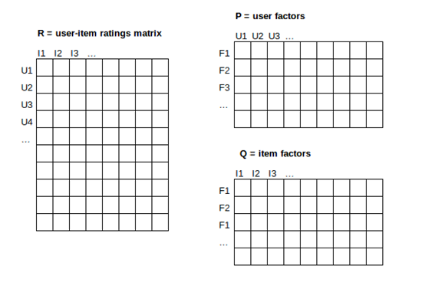
Dimensionality Reduction

Slide 19
Dimensionality Reduction
UV-decomposition (instance of SVD)
Used to estimate the blank spaces in the sparse utility matrix
Assumption is that Utility Matrix ~ Product of two long, thin matrices

Slide 20
Dimensionality Reduction
Sparse Matrix M (n x m) = Matrix U (n x d) x Matrix V (d x m)
UV matrix is used to approximate blank entries in M
Both user and items can now be characterized using only d dimensions

